Slide 1
A Virtual Personal Assistant (VPA) for Bengali with Machine Learning (ML) and Reinforcement Learning (RL)
Sadidul Islam
ID: 0122310026
Course: Research Methodologies and Technical Writing

Slide 2


Problem
The problems varies for each person based on their health condition, here we are describing couple of them -
Disabled People Disabled people who can’t use or don’t have hands or eyes to do things like the normal people can, e.g. calling person, controlling light, fan etc.
Busy People It is tough for a busy person to find time to setup a meeting schedule, query some on his own while he was doing other important things.

Slide 3

Why?
7th largest speaking language
Bengali is not covered in this area.
18% english speaker
25.34% illiterate
2.48% verbal disabled people

Slide 4

Virtual Personal Assistant
Speak to do things
Speak in your own language with technology

Slide 5
Literature Review

Slide 6
Adheetee: A Comprehensive Bangla Virtual Assistant
developed based on Natural Language Understanding (NLU) using Deep Learning (DL) models
such as Recurrent Neural Network (RNN) for Bangla Language.
They have collect and created their own corpus then trained the model on that dataset.
Reference - 1
Syed Mohidul Islam, Most Fowziya Akther Houya, Syed Mynul Islam, Salekul Islam and Nahid Hossain, Adheetee: A Comprehensive Bangla Virtual Assistant, 2019.

Slide 7
In the paper "Large-Scale Personal Assistant Technology Deployment,
specifically in the context of the Siri Experience",
the researchers provided a lot of information about development and deployment a production grade Siri,
Siri is a virtual personal assistant developed by Apple.
They have showed how they have implemented architecture,
deployment architecture and how they have improved performance Natural Language Processing (NLP) and Natural Language Understanding (NLU) capabilities.
Reference - 2
Jerome R. Bellegarda, ``Large–Scale Personal Assistant Technology Deployment: the Siri Experience, 2013.

Slide 8
The paper State of Art Research in Bengali Speech Recognition
presents a comprehensive methodology for advancing the field of Bengali speech recognition.
They have pointed out about challenges specific to Bengali speech recognition.
The researchers proposed a hybrid approach of that combines acoustic modeling, language modeling, and lexical modeling
using Convolutional Neural Network (CNN), Recurrent Neural Network (RNN) to improve accuracy and performances.
Reference - 3
S.M. Saiful Islam Badhon, Md. Habibur Rahaman, Farea Rehnuma Rupon, State of art Research in Bengali Speech Recognition, 2020.

Slide 9
The paper "Doly: Bengali Chatbot for Bengali Education" presents the methodology employed to
develop an intelligent chatbot named Doly, designed specifically for Bengali language education.
The methodology emphasizes the importance of continually updating and
expanding Doly's knowledge base to keep up with evolving educational content and trends.
Reference - 4
Md. Kowsher, Farhana Sharmin Tithi, M Ashraful Alam, Mohammad Nurul Huda, Mir Md Moheuddin, Md. Golam Rosul, Doly: Bengali Chatbot for Bengali Education, 2019.

Slide 10
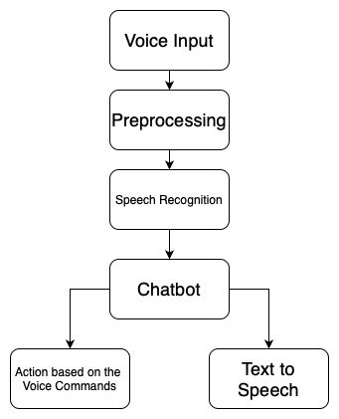
System Architecture

Slide 11
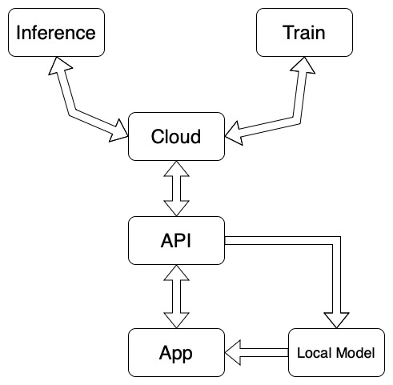
Deployment architecture

Slide 12

Thank you!
Please feel to ask questions.

